Slide 1



Amazon Sales Dashboard
View in Power BI
Last data refresh:
10/24/2025 3:58:49 PM UTC
Downloaded at:
10/28/2025 4:55:51 PM UTC

Slide 2
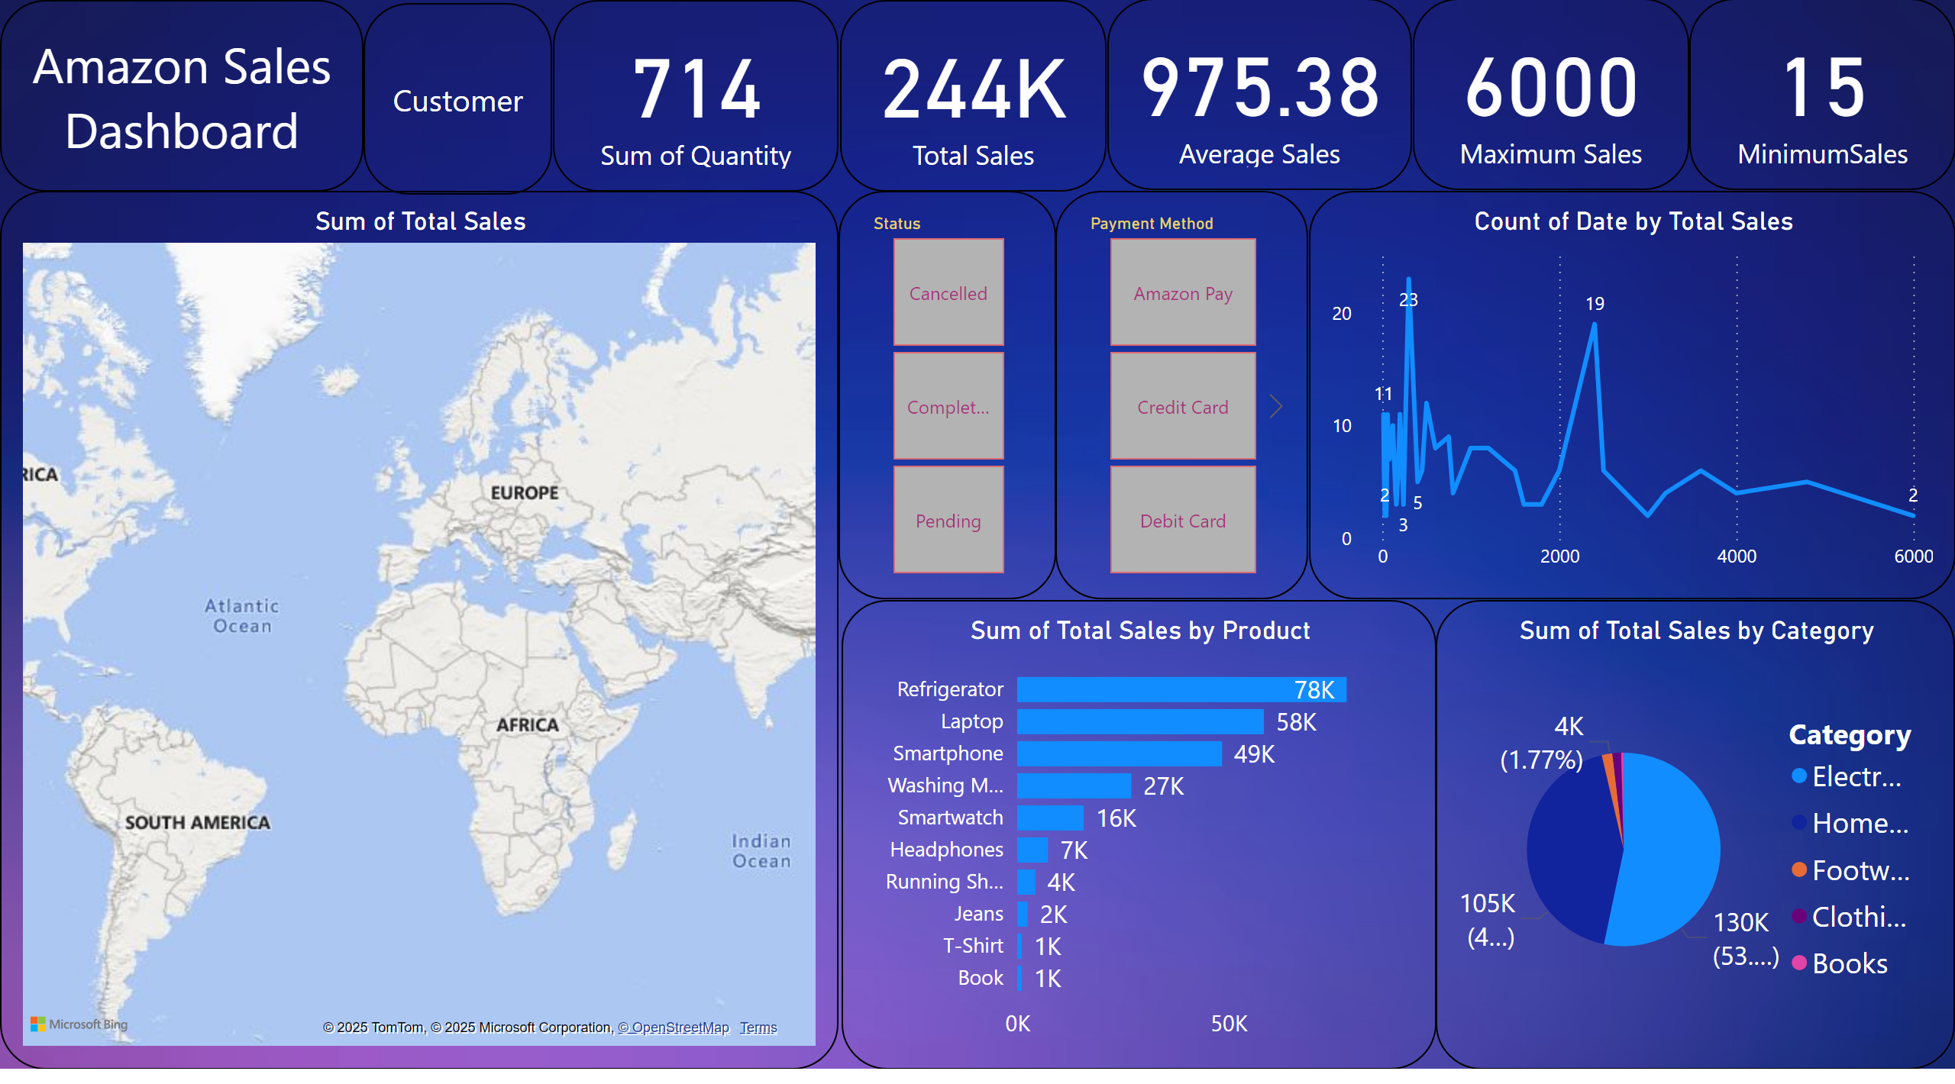
Overall Sales Dashboard
Notes:
card
No alt text provided
card
No alt text provided
card
No alt text provided
card
No alt text provided
card
No alt text provided
lineChart
No alt text provided
barChart
No alt text provided
pieChart
No alt text provided
map
No alt text provided
Amazon Sales Dashboard
No alt text provided
slicer
No alt text provided
slicer
No alt text provided
Amazon Sales Dashboard
No alt text provided

Slide 3
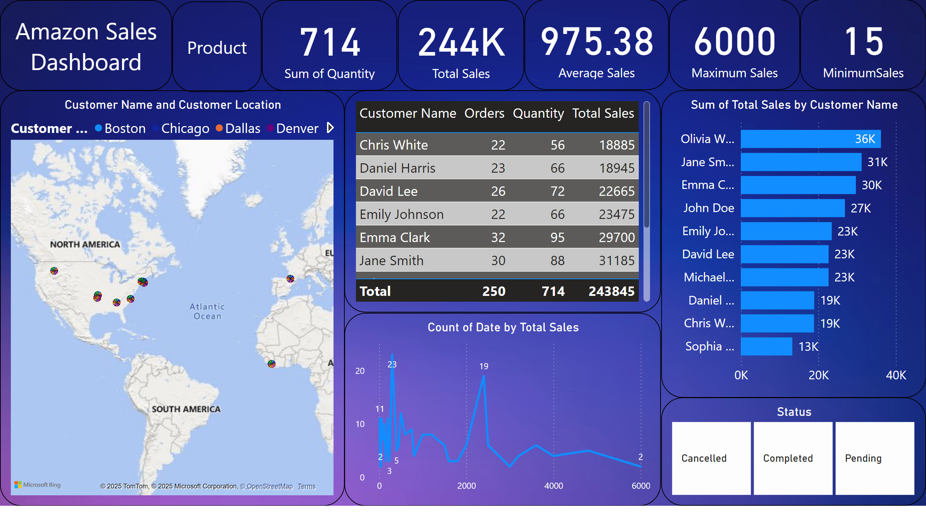
Customer Insights
Notes:
card
No alt text provided
card
No alt text provided
card
No alt text provided
card
No alt text provided
card
No alt text provided
lineChart
No alt text provided
barChart
No alt text provided
Amazon Sales Dashboard
No alt text provided
map
No alt text provided
tableEx
No alt text provided
advancedSlicerVisual
No alt text provided
Amazon Sales Dashboard
No alt text provided

Slide 4
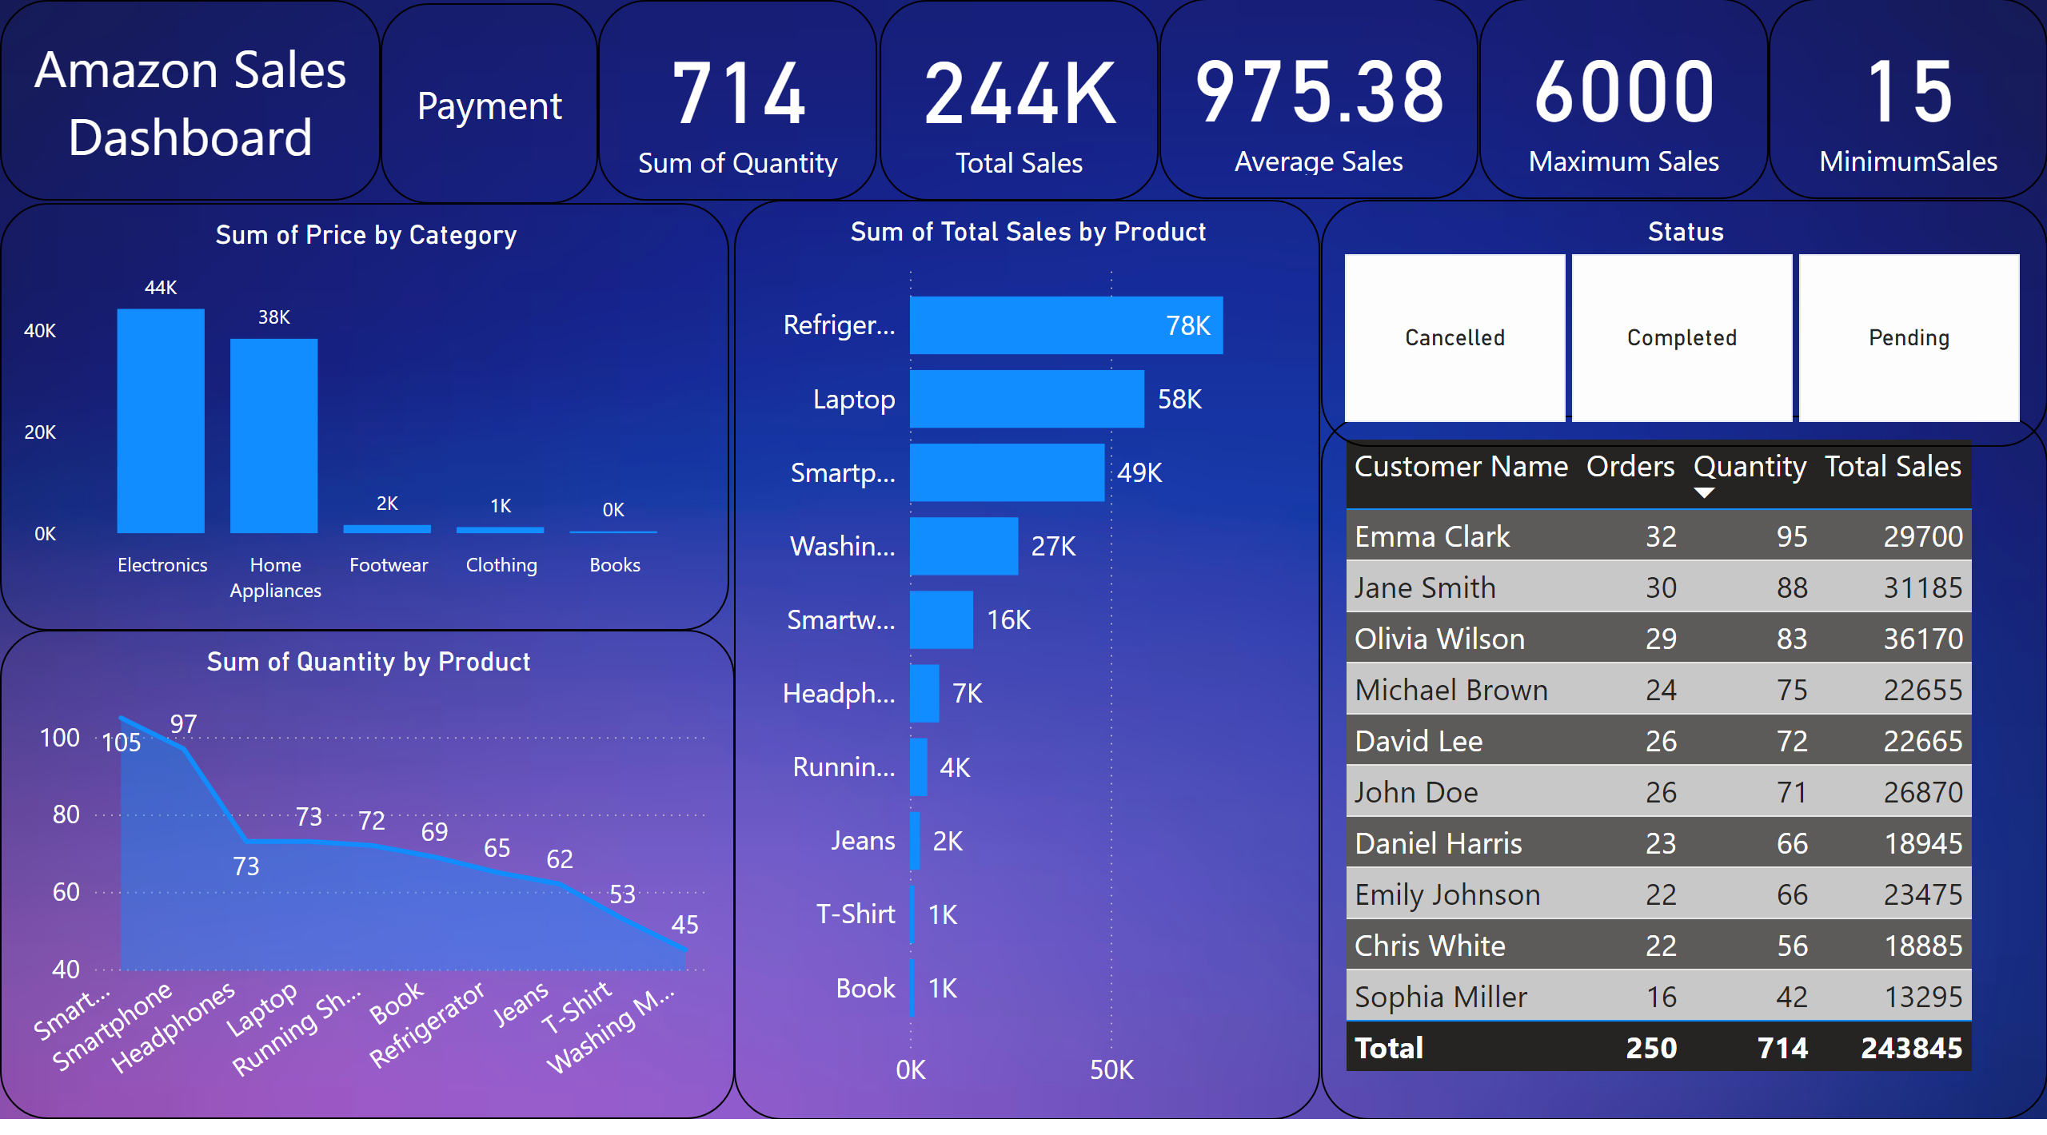
Product Analysis
Notes:
card
No alt text provided
card
No alt text provided
card
No alt text provided
card
No alt text provided
card
No alt text provided
clusteredColumnChart
No alt text provided
barChart
No alt text provided
Amazon Sales Dashboard
No alt text provided
areaChart
No alt text provided
tableEx
No alt text provided
advancedSlicerVisual
No alt text provided
Amazon Sales Dashboard
No alt text provided

Slide 5
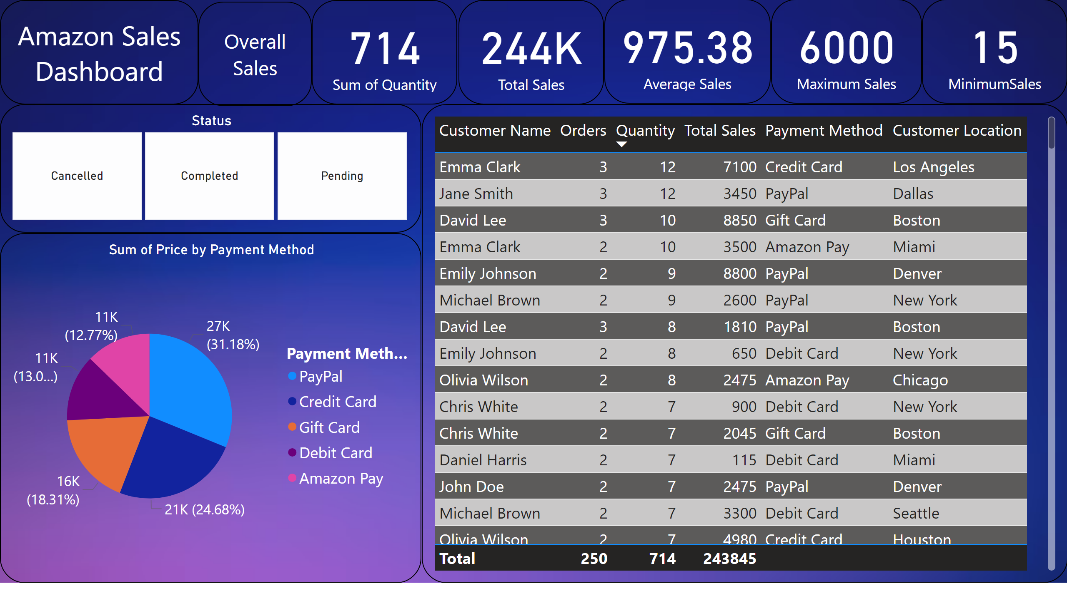
Payment Method
Notes:
Amazon Sales Dashboard
No alt text provided
advancedSlicerVisual
No alt text provided
tableEx
No alt text provided
Amazon Sales Dashboard
No alt text provided
pieChart
No alt text provided
card
No alt text provided
card
No alt text provided
card
No alt text provided
card
No alt text provided
card
No alt text provided

